Slide 1
Chapter 5: Essential Algebra

Slide 2
Groups
A group is an algebraic system consisting of a set, an identity element, one operation, and its inverse operation.
An identity element is some number within a set that you can apply some operation to any other number in the set, and the other number will still be the same. Put mathematically,
    a * I = a
where * is any operation that we might specify, not necessarily multiplication. An example would be with respect to the addition operation, 0 is the identity element. If you add 0 to any number, you still have the same number. With respect to multiplication, 1 is the identity element. Any number multiplied by 1 results in the same number.

Slide 3
Abelian Group
An abelian group, or commutative group, has an additional property called the commutative property:
    a + b = b + a, if the operation is addition
and
    ab = ba, if the operation is multiplication.

Slide 4
Cyclic Group
A cyclic group has elements that are all powers of one of its elements. So, for example, if you start with element x, then the members of a cyclic group would be
    x⁻², x⁻¹, x⁰, x¹, x², x³, ….
Of course, the requirements for a group would still apply to a cyclic group. The basic element x is considered to be the generator of the group, since all other members of the group are derived from it. It is also referred to as a “primitive element” of the group. Integers could be considered a cyclic group, with 1 being the primitive element (the generator).

Slide 5
Rings
A ring is an algebraic system consisting of a set, an identity element, two operations, and the inverse operation of the first operation.
A ring is essentially an abelian group that has a second operation.
A set of integers with the addition operation form a group, and furthermore they form an abelian group. If you include the multiplication operation, the set of integers with both the addition and the multiplication operations form a ring.

Slide 6
Fields
A field is an algebraic system consisting of a set, an identity element for each operation, two operations, and their respective inverse operations.
You can think of a field as a group with two operations rather than one, and it has an inverse for both of those operations. Every field is a ring, but not every ring will necessarily be a field.

Slide 7
Galois Fields
Galois fields are also known as finite fields because they have a finite number of elements. The groups, rings, and fields previously discussed, were all infinite. The set of integers, rational numbers, and real numbers are all infinite. Galois fields are finite.
In a Galois field, there are some integers such that n repeated terms equals 0. Put another way, there is some boundary on the field that makes it finite. You will often see a Galois field defined as follows: GF(p^{n}).
In this case, the Galois field does not denote a function; in other words, a Galois field has p as the prime number (the characteristic mentioned previously in this section) and the field has p^{n} elements. So, a Galois field is some finite set of numbers (from 0 to p^{n} – 1) and some mathematical operations (usually addition and multiplication), along with the inverses of those operations.

Slide 8
Diophantine Equation
In a Diophantine equation, you are interested only in the integer solutions to the equation. Thus, a linear Diophantine equation is a linear equation ax + by = c with integer coefficients for which you are interested only in finding integer solutions.
There are two types of Diophantine equations:
Linear Diophantine equations have elements that are of degree 1 or 0.
Exponential Diophantine equations have at least one term that has an exponent greater than 1.
The simplest Diophantine equations are linear and are of the form
  ax + by = c

Slide 9
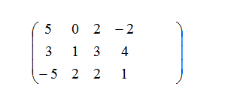
Matrix
A matrix is a rectangular arrangement of numbers in rows and columns.
Rows run horizontally and columns run vertically. The dimensions of a matrix are stated m x n where m is the number of rows and n is the number of columns.
Here is an example:

Slide 10
Types of Matrices
There are different types of matrices:
Column matrix: A matrix with only one column
Row matrix: A matrix with only one row
Square matrix: A matrix that has the same number of rows and columns
Equal matrices: Two matrices that have the same number of rows and columns (the same dimensions) and all their corresponding elements are exactly the same
Zero matrix: Contains all 0’s

Slide 11


Matrix Addition
If two matrices are the same size, they can be added together by adding each element together. Consider the following example:
Start with the first row and first column in the first matrix (which is 1) and add that to the first row and the first column of the second matrix (which is 3); thus in the sum matrix, the first row and first column is 3 + 1 = 4. You repeat this for each cell.
Subtraction works similarly:

Slide 12

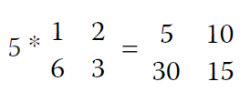
Matrix Multiplication
You can multiply two matrices only if the number of columns in the first matrix is equal to the number of rows in the second matrix. First, let’s take a look at multiplying a matrix by a scalar (a single number). For example,
Multiply the scalar value by each element in the matrix:

Slide 13
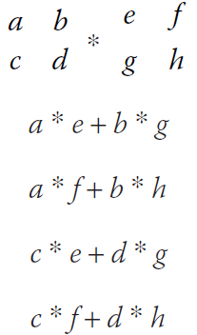

Matrix Multiplication
Multiplication of two matrices is a bit more complex. You multiply each element in the first row of the first matrix by each element in the first column of the second matrix. Then you multiply each element of the second row of the first matrix by each element of the second column of the second matrix.
Let’s look at a conceptual example:
The product will be

Slide 14
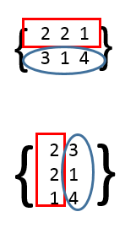
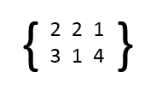
Matrix Transposition
Matrix transposition simply reverses the order of rows and columns. While we have focused on 2 x 2 matrices, the transposition operation is most easily seen with a matrix containing more rows and columns.
transposes to

Slide 15
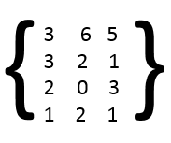
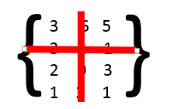
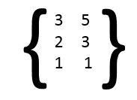
Submatrix
A submatrix is any portion of a matrix that remains after deleting any number of rows or columns.
Consider this matrix:
If you remove the second column and second row,
as shown here,
you are left with this matrix:
That matrix is a sub-matrix of the original matrix.

Slide 16
Identity Matrix
An identity matrix is rather simple.
Think back to the identity property of groups. An identity matrix accomplishes the same goal, so that multiplying a matrix by its identity matrix leaves it unchanged.
To create an identity matrix, set all the elements along the main diagonal to 1, and set the rest to 0.

Slide 17
Algorithms
An algorithm is a systematic way of solving a problem.
A recipe for an apple pie is an algorithm. If you follow the procedure, you get the desired results. Algorithms are a routine part of computer programming. Often the study of computer algorithms centers on sorting algorithms. The sorting of lists is a very common task and therefore a common topic in any study of algorithms.
Asymptotic analysis is a process used to measure the performance of computer algorithms. This type of performance is based on a factor called computational complexity, which is usually a measure of either the time it takes for an algorithm to work or the resources (memory) needed. Note that you can usually optimize time or resources, but not both. The asymptotic upper bound is the worst-case scenario for the given algorithm, whereas the asymptotic lower bound is a best case.

Slide 18
Big O Notation
Perhaps the most common way to evaluate the efficacy of a given algorithm is Big O notation. This method measures the execution of an algorithm, usually the number of iterations required, given the problem size n.
In sorting algorithms, n is the number of items to be sorted. Stating some algorithm f(n) = O(g(n)) means it is less than some constant multiple of g(n). The notation is read, “f of n is Big O of g of n.” Saying an algorithm is 2N means it will have to execute twice the number of items on the list.
Big O notation measures the asymptotic upper bound of a function. It is also the most often used analysis.

Slide 19
Omega and Theta
Omega notation is the opposite of Big O notation. It is the asymptotic lower bound of an algorithm and provides the best case scenario for that algorithm. It gives you the minimum running time for an algorithm.
Theta notation combines Big O and Omega to provide the average case (average being arithmetic mean in this situation) for the algorithm. In our analysis, we focus heavily on the Theta, also often referred to as the Big O running time. This average time gives a more realistic picture of how an algorithm executes.

Slide 20
Quick Sort
The quick sort is a very commonly used algorithm.
Like the merge sort, it is recursive, meaning that it calls itself repeatedly until the list is sorted. Some books refer to the quick sort as a more effective version of the merge sort.
The quick sort is the same as a merge sort (n ln n), but the difference is that this is also its best case scenario. However, it has an O (n²), which indicates that its worst case scenario is quite inefficient. So for very large lists, the worst case scenario may not be acceptable.

Slide 21
Bubble Sort
The bubble sort is the oldest and simplest sort in use; from a programmatic point of view it is very easy to implement. Unfortunately, it’s also one of the slowest. It has an O (n²). This means that for very large lists, it is probably going to be too slow. As with most sort algorithms, its best case (lower asymptotic bound) is O(n).
The bubble sort works by comparing each item in the list with the item next to it and swapping them if required. The algorithm repeats this process until it makes a pass all the way through the list without swapping any items (in other words, all items are in the correct order). This causes larger values to “bubble” to the end of the list, while smaller values “sink” toward the beginning of the list, thus the name of the algorithm.
The bubble sort is generally considered to be the most inefficient sorting algorithms in common use. Under best-case conditions (the list is already sorted), the bubble sort can approach a constant O(n) level of complexity. General-case is an O(n2).

Slide 22
Euclidean Algorithm
The Euclidean algorithm is a method for finding the greatest common denominator of two integers.
That may sound like a trivial task, but with larger numbers it is not. The Euclidean algorithm plays a role in several cryptographic algorithms presented in the book.
The Euclidian algorithm proceeds in a series of steps such that the output of each step is used as an input for the next one.
Let k be an integer that counts the steps of the algorithm, starting with 0. Thus, the initial step corresponds to k = 0, the next step corresponds to k = 1, then k = 2, k = 3, and so on.

